Slide 1
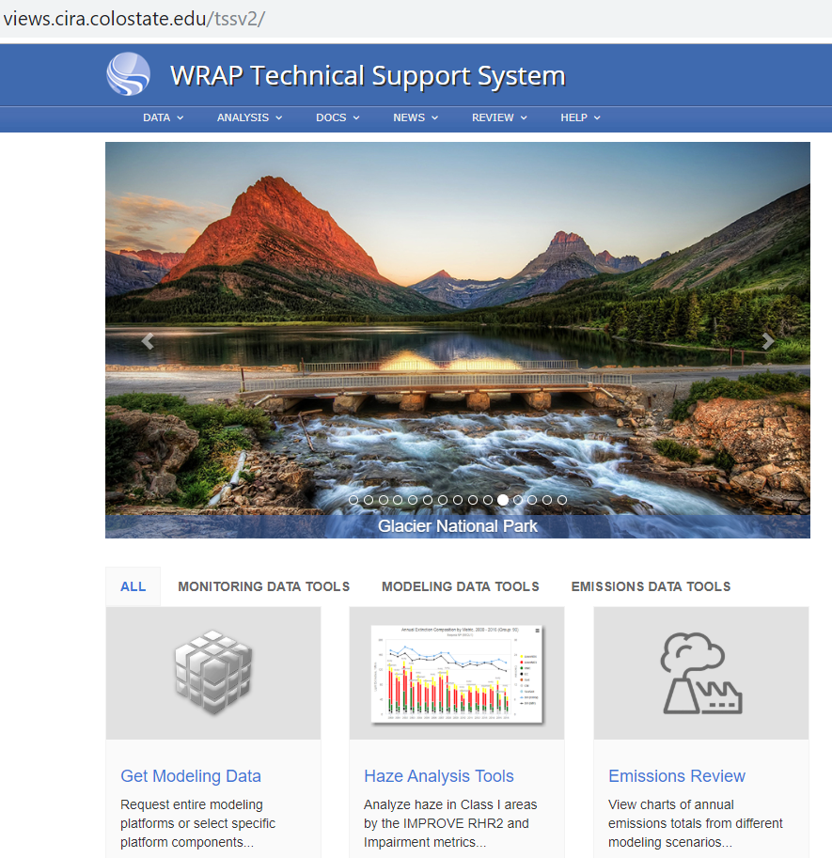
WRAP Technical Support System 2 hosts the technical analyses and graphics supporting states’ Regional Haze Plans
http://views.cira.colostate.edu/tssv2/
Communication and Glidepath Subcommittee
October 10 TSS2 Design Deliverables

Slide 2
WRAP Technical Support System 2 hosts the technical analyses and graphics supporting states’ Regional Haze Plans
http://views.cira.colostate.edu/tssv2/
Communication and Glidepath Subcommittee
October 10 TSS2 Design Deliverables
Current Home Page

Slide 3
WRAP Technical Support System 2 hosts the technical analyses and graphics supporting states’ Regional Haze Plans
http://views.cira.colostate.edu/tssv2/
Under development: TSS2 SIP Deliverables Design Layout
Proposed layout similar to TSS1
Class I Summary
Monitoring
Emissions
Modeling

Slide 4
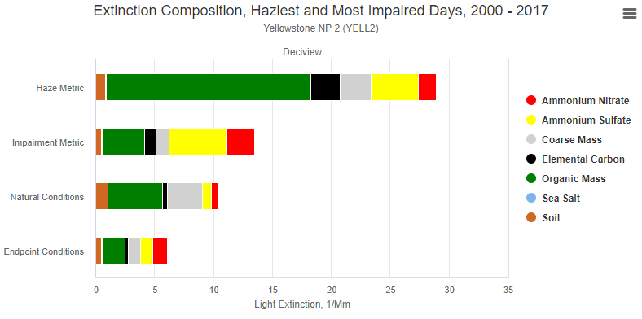
For each Class I area in state, for most impaired days and clearest days, define baseline, current, and natural visibility conditions
Example graphic layout for Most Impaired Days. Ignore specific values.
Extinction Composition, Most Impaired Days
Yellowstone NP
Deciview
20
14
9
2000-2004
IMPROVE
2013-2017
IMPROVE
2064 Natural
Visibility Goal*
Aerosol Light Extinction, Mm-1
*based on IMRPOVE 2000-2014 data and EPA methods

Slide 5
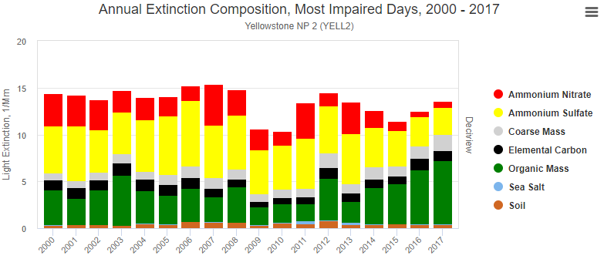
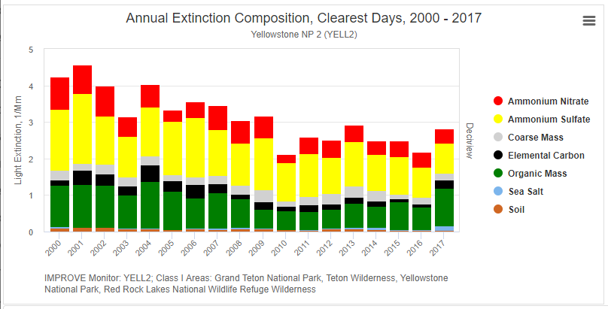
For each Class I area in state, for most impaired and clearest days, define visibility trends and aerosol contributions
Most Impaired days (defined using IMPROVE data and EPA methods)
Clearest days (defined using IMPROVE and EPA methods)
Reset vertical axis so same scale as MID

Slide 6
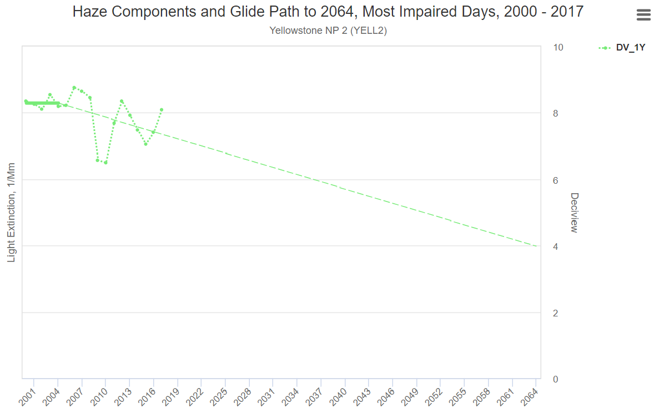
Uniform Rate of Progress Glidepath based on IMPROVE Monitoring Data and EPA default assumptions*
Regional Haze Glide Path to 2064 for most impaired days, compared to IMPROVE monitoring data 2000-2018
10
2000-2004 5 yr ave
Yellowstone National Park
2014-2018 5 yr ave
8
6
Deciview, dv
4
2
0
*EPA Regional Haze Guidance Dec 2018
4
Need to revise left axis to DV.
Remove right axis DV.
Larger fonts and heavier lines.

Slide 7
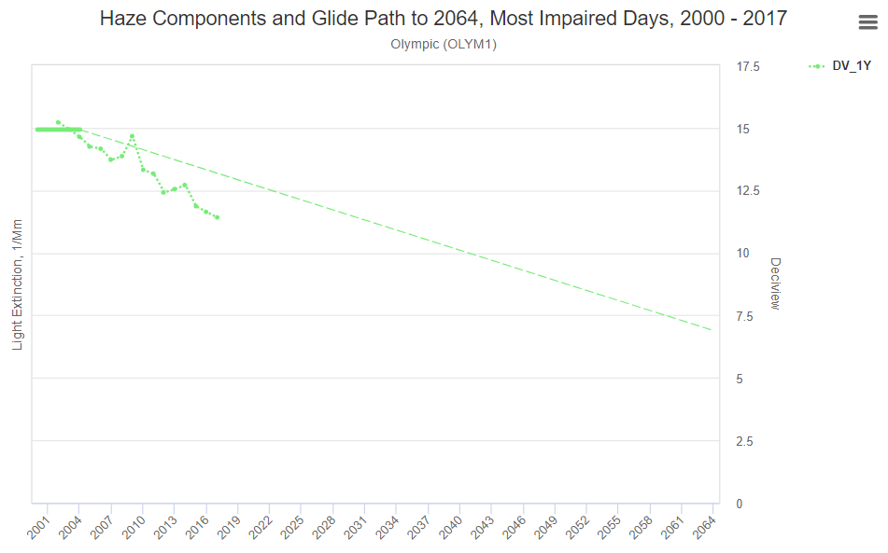
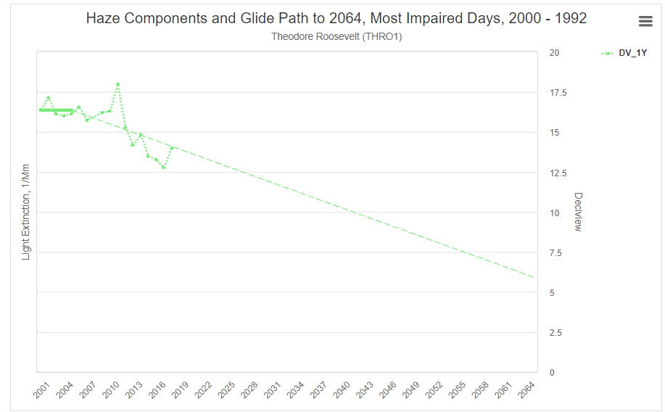
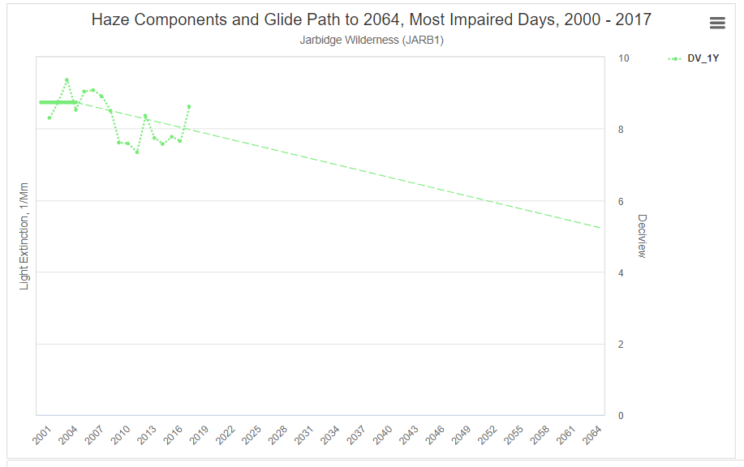
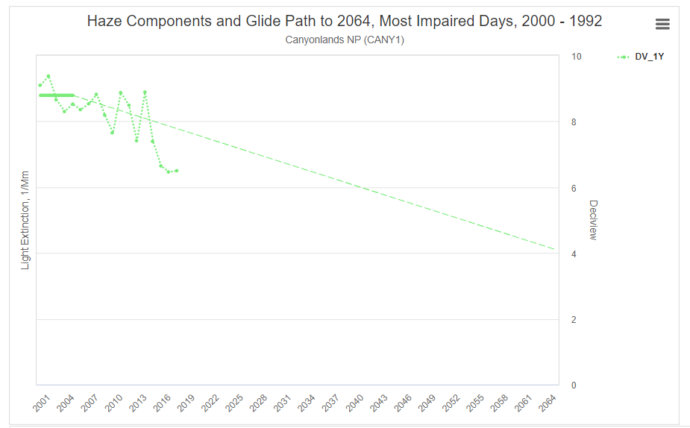

Slide 8
Figure B. Glidepath based on IMPROVE Visibility Monitoring Data plus 2014_v2 Modeling Results
Regional Haze Glide Path to 2064 for most impaired days, compared to IMPROVE monitoring data 2000-2018
IMPROVE monitoring
10
2000-2004 5 yr ave
Yellowstone National Park
2014-2018 5 yr ave
8
CAMx Modeling
2014 v2 Actual
6
Hypothetical value, not model results
Deciview, dv
4
2
0

Slide 9
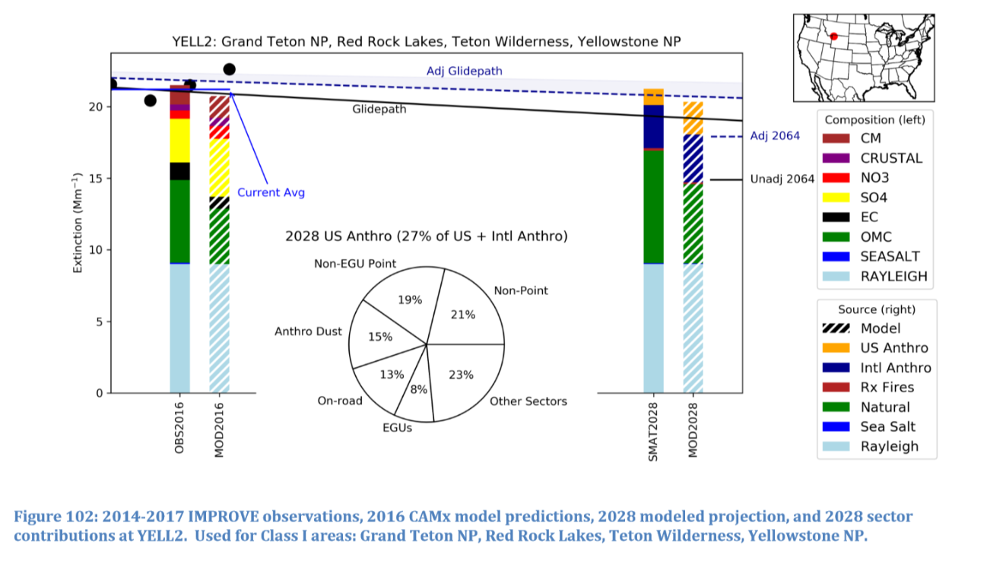
TSS2 will create graphics illustrating WRAP modeling results.
From EPA Sept 2019 Modeling Report

Slide 10
From Washington using TSS1 Class I Summary Tables
[to be redesigned on TSS2]
Washington’s Mandatory | Most Impaired Days |  |  |  | Clearest Days
Class I Areas | 2000-04 Baseline [deciviews] | 2064 Natural Conditions [deciviews] | Difference [deciviews] | 2018 Target Value for a | 2000-04 Baseline [deciview] | 2064 Natural Conditions [deciview] | Difference [deciviews]
 |  |  |  | Uniform Rate of Progress
 |  |  |  | [deciview]
Olympic National Park
North Cascades National Park and Glacier Peak Wilderness
Alpine Lakes Wilderness
Mount Rainier National Park
Goat Rocks Wilderness and Mount Adams Wilderness
Pasayten Wilderness

Slide 11
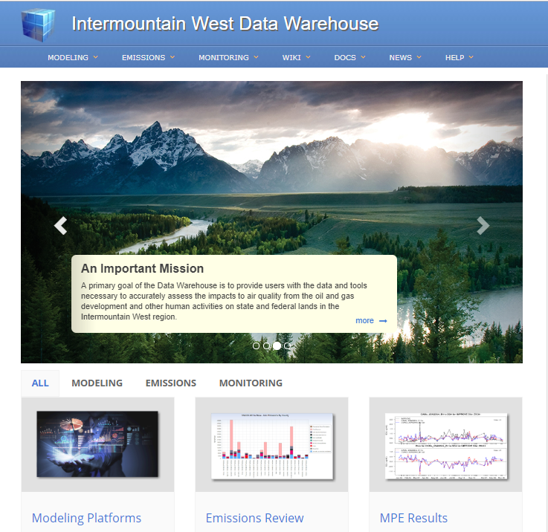
Intermountain West Data Warehouse will host more detailed emissions and air quality modeling results than TSS2
Example emissions chart from IWDW

